Slide 1
The impact of green bonds on stock returns
Lorenzo Cerreta
Supervisor: professor Hannes Wagner
Bocconi University

Slide 2

What is a green bond?
In theory:
An obligation financing projects with a positive impact on either the climate or the environment

Slide 3
What is a green bond?
In practice:
No clear definition
In 2017, Repsol’s green bond issued to lower the emissions of its fossil fuel burning plants was removed from green bond indexes because it supported the fossil fuel industry, even though ICMA lists “pollution prevention and control” among green bonds’ possible uses of proceeds
Little control after issuance
Ehlers and Packer (2017) notice that green bond certifications usually lack assessment procedures after the issuance of the certification and verify compliance only in a single moment in time
No protection in case of “green default”
Corke and Myers (2019) find the usual market practice stating that “a loss of certification does not constitute an event of default and bondholders cannot exercise redemption rights or take any other action”
Notes:
before providing the certificate. For instance, they find that both CICERO and Standard & Poor's Green Evaluations do not verify “green compliance” after the initial assessment, and only for Moody’s Green Bond Assessments “regular review is anticipated”.

Slide 4



Why issuing a green bond?
Cons of issuing a green bond:
Possible rationales for a green bond:
Constrain on use of proceeds (only projects with a positive impact on the climate and the environment)
Signalling or Faking the company’s commitment towards the environment
Additional administrative and compliance costs (even more so in case of a third-party certification)
Accessing cheaper financing
Source: Larcker and Watts (2019), Flammer (2020)

Slide 5
Green bonds: Not a cheaper source of capital
Ehlers and Packer (2017):
Green bonds by the same issuer trade at a premium with respect to regular bonds, but at a non-statistically significant level due to high variance
Gingliner and Moreau (2019):
No premium for green bonds issued by French companies
Larcker and Watts (2019):
Municipal green and non-green bonds in the United States issued by the same entity on the same day experience identical pricing by financial markets
Cheaper financing theory does not hold:
green bonds must bring other benefits to companies, or such a costly source of funds would not be pursued
Notes:
Literature appears to reach consensus over the fact that green bonds do not unlock a lower cost of borrowing

Slide 6
Why issuing a green bond?
Even though green bonds do not unlock cheaper sources of funds, they might:
Attract a broader range of investors, including long-term, institutional and responsible investors
Signal that the company is able to cope with the always increasing environmental regulations and external pressure
Replicate event study by Flammer (2020) with a different and bigger dataset
Source: Refinitiv Workspace, corporate bonds labelled as “green bonds”

Slide 7
Dataset
1805 corporate green bonds issued worldwide between 2013 and 2019 included
Data including amount issued, date of issue, first date of announcement, parent id, maturity, coupon
Issuer | ISIN | Amount Issued (USD) | Issue Date | Maturity | Coupon | Issuer Type | Sector | Country of Incorporation | Use of Proceeds | First Announcement Date
KfW | XS1890845875 | $ 4,651,974,181 | 22/05/2019 | 05/05/2027 | 0.01 | Agency | Agency | Germany | Eligible Green Projects | 15/05/2019
Industrial Bank Co Ltd | CND10000C3L5 | $ 4,397,537,379 | 30/10/2018 | 01/11/2021 | 3.99 | Corporate | Banking | China | Eligible Green Projects | 25/10/2018
Societe du Grand Paris | XS1591694481 | $ 2,907,483,863 | 03/06/2019 | 25/05/2050 | 1.7 | Agency | Agency | France | Other Transportation | 22/05/2019
Apple Inc | US83417KEP93 | $ 1,500,000,000 | 23/02/2016 | 23/02/2023 | 2.85 | Corporate | Electronics | United States | Acquisition | 16/02/2016
Bank of America Corp | INE028A08083 | $ 2,250,000,000 | 17/05/2018 | 17/05/2022 | 3.499 | Corporate | Banking | United States | Eligible Green Projects | 14/05/2018
Engie SA | US50048MCD02 | $ 1,511,891,609 | 19/05/2014 | 19/05/2026 | 2.375 | Corporate | Oil and Gas | France | Alternative Energy | 12/05/2014
Bank of Beijing Co Ltd | CND1000163S9 | $ 2,198,768,689 | 28/11/2017 | 30/11/2020 | 4.9 | Corporate | Banking | China | Eligible Green Projects | 23/11/2017
A snapshot of the dataset

Slide 8
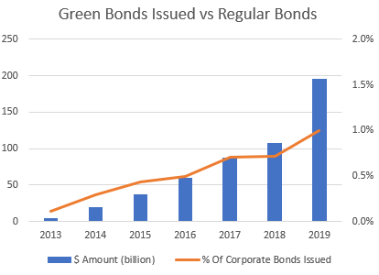
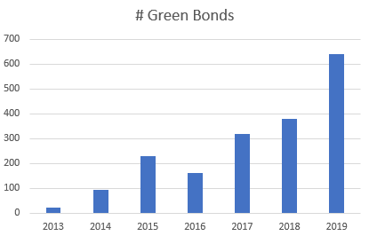
The green bond “boom”

Slide 9
Breakdown by sector
Sector | # Bonds | $ Amount (billion)
Banking | 378 | 139.11
Agency | 223 | 122.82
Financial - Other | 326 | 99.76
Utility - Other | 420 | 60.24
Service - Other | 61 | 12.94
Oil and Gas | 19 | 11.59
Home Builders | 157 | 11.16
Mortgage Banking | 13 | 7.66
Real Estate Investment Trust | 35 | 6.43
Electronics | 15 | 6.18
Transportation - Other | 24 | 5.07
Chemicals | 7 | 3.17
Life Insurance | 7 | 3.15
Industrials - Other | 7 | 2.74
Telecommunications | 3 | 2.09
Leasing | 14 | 2.08
Machinery | 7 | 1.67
Railroads | 17 | 1.64
Building Products | 18 | 1.51
Gas Utility - Local Distrib | 4 | 1.38
Retail Stores - Other | 7 | 1.30
Conglomerate/Diversified Mfg | 7 | 1.17
Food Processors | 2 | 1.16
Total | 1805 | 509.04
Financial and banking sectors play a big role in the green bonds market, together with building and utility industries
Agency sector is the second most represented segment, showing that government owned businesses are very interested in environmental-friendly operations as pointed out by Chen, Sinha and Dong (2019)

Slide 10
Dataset statistics
Index | All | Parent Private | Parent Public | Private | Public
# Green bonds | 1805 | 1038 | 766 | 1348 | 456
# Green bond issuer-days | 1303 | 786 | 516 | 917 | 385
# Green bond issuer-years | 929 | 523 | 406 | 614 | 315
# Green bond issuers | 643 | 333 | 310 | 413 | 230
Amount (in $M) | 282.17 | 275.12 | 292.03 | 252.24 | 371.35
Amount (in $M) SD | 0.44 | 0.42 | 0.46 | 0.40 | 0.53
Maturity (years) | 8.62 | 9.39 | 7.59 | 7.76 | 11.22
Maturity (years) SD | 33.87 | 44.27 | 6.76 | 6.61 | 66.47
Fixed-rate bond | 0.79 | 0.77 | 0.81 | 0.8 | 0.76
Fixed-rate bond SD | 2.35 | 2.49 | 2.14 | 2.3 | 2.37
Coupon (for fixed-rate bonds) | 3.26 | 3.39 | 3.09 | 3.48 | 2.57
Coupon (for fixed-rate bonds) SD | 2.35 | 2.49 | 2.14 | 2.3 | 2.37
Key takeaways:
Companies with public parent experience:
lower standard deviation in
duration
coupon rate
a higher share of fixed-rate coupons
slightly bigger loans on average
Public companies often issue bonds through their subsidiaries
Public companies experience a longer maturity for the bonds they issue, but the opposite is true for companies with public ultimate parent

Slide 11
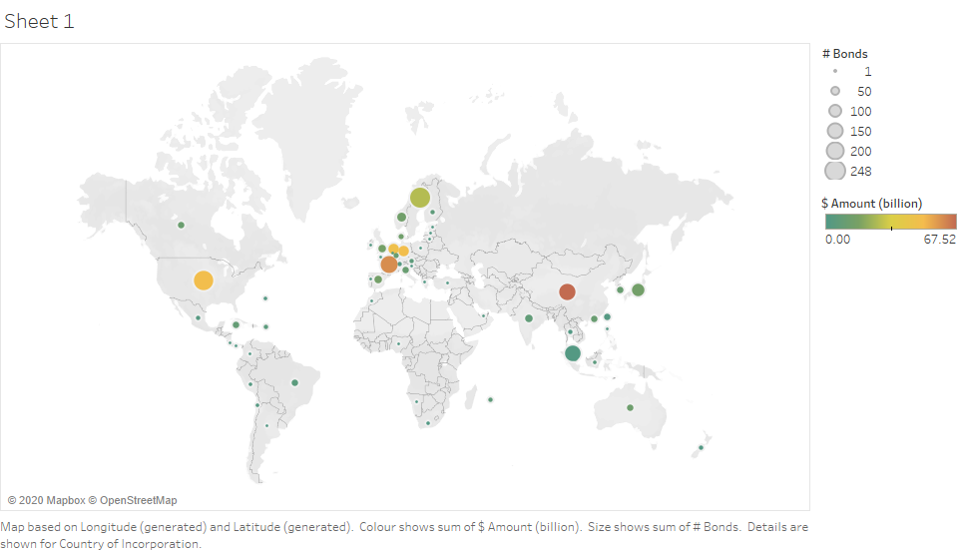
Corporate green bonds by country

Slide 12
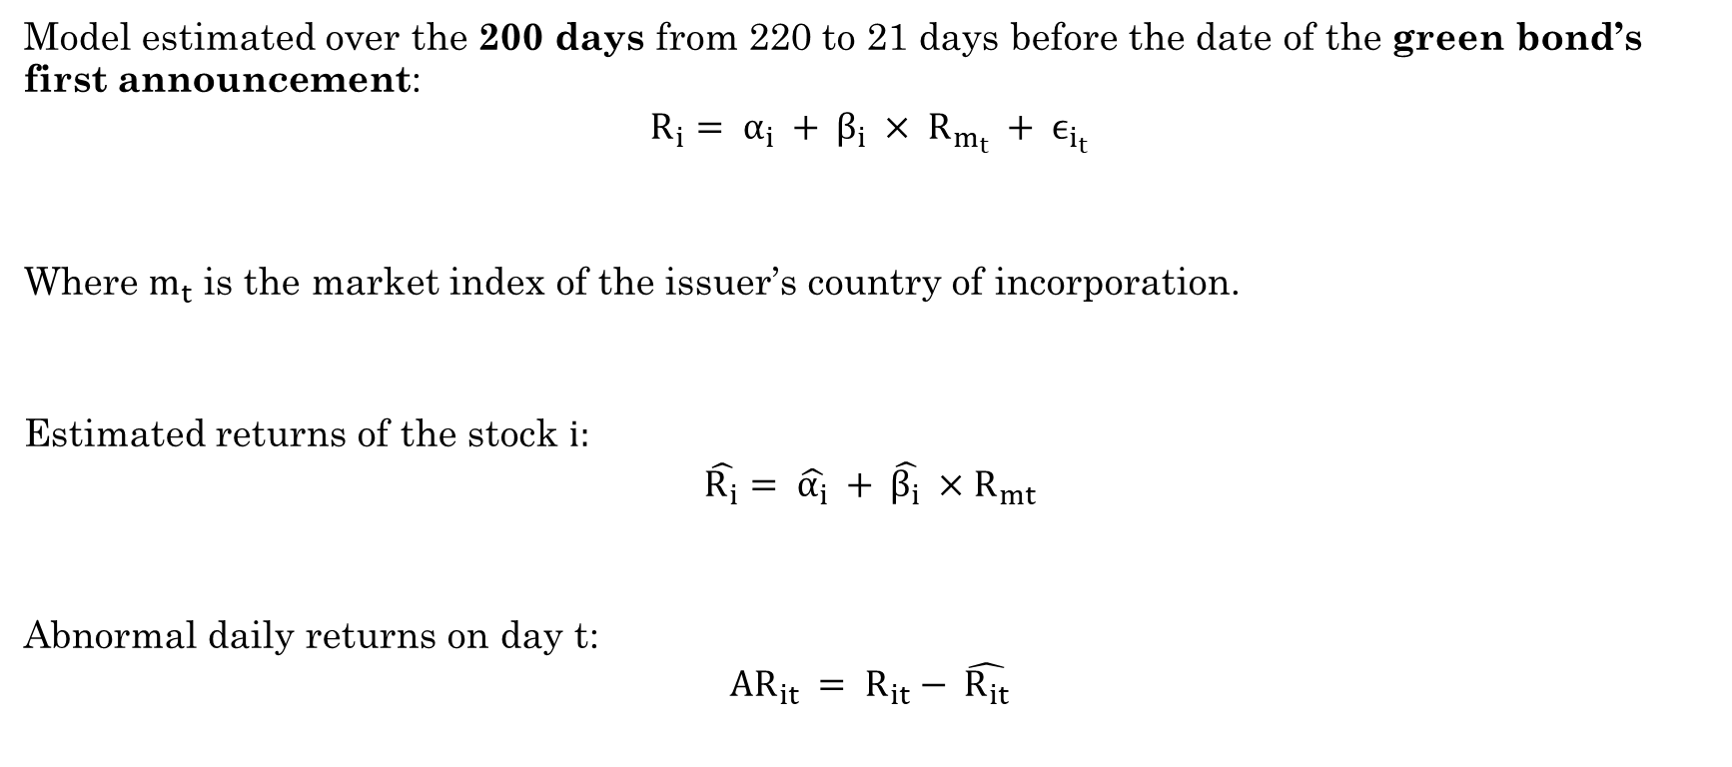
Market model
Model estimated over the 200 days from 220 to 21 days before the date of the green bond’s first announcement:
$$R_{i}= α_{i} + β_{i} × R_{m_{t}} + ϵ_{i_{t}}$$
Where $m_{t}$ is the market index of the issuer’s country of incorporation.
Estimated returns of the stock $i:$
$$\hat{R_{i}}= \hat{α_{i}} + \hat{β_{i}} ×R_{mt}$$
Abnormal daily returns on day t:
$$AR_{it} = R_{it}− \hat{R_{it}}$$

Slide 13
Event study results (N=494)
Event time | CAR | Std. Err.
[-20, -11] | 0.305 | 0.200
[-10, -6] | 0.045 | 0.136
[-5, 10] | 0.529** | 0.247
[11, 20] | 0.127 | 0.178
[21, 60] | 0.018 | 0.501
** denotes significance at the 5% level

Slide 14
Event study results
First-time issuers (N=242)
Seasoned issuers (N=252)
Event time | CAR | Std. Err.
[-20, -11] | 0.701** | 0.287
[-10, -6] | -0.077 | 0.172
[-5, 10] | 0.065 | 0.370
[11, 20] | 0.162 | 0.252
[21, 60] | 0.081 | 0.814
Event time | CAR | Std. Err.
[-20, -11] | -0.075 | 0.275
[-10, -6] | 0.162 | 0.210
[-5, 10] | 0.974*** | 0.328
[11, 20] | 0.093 | 0.252
[21, 60] | -0.042 | 0.602
** and *** respectively denote significance at the 5% and 1% level

Slide 15
Key findings
Like Flammer (2020), evidence of statistically significant positive CAR in the time window [-5, 10] around the announcement of a green bond
Unlike Flammer, significant CAR for seasoned issuers too: repeated signalling appears to unlock even more value
Unlike Flammer, significant CAR for first-time issuers in [-20, -11]: information for first-time issuers appears both to leak sooner than for seasoned ones and to cause lower CAR than for seasoned issuers

Slide 16

Possible improvements
Ehlers and Packer (2017) find big differences between The Climate Bond Initiative’s and Bloomberg’s datasets for green bonds. Merging databases of green bonds from Refinitiv Workspace, Bloomberg, and CBI should allow to closely map the entirety of the green bonds market
The code used in this research thesis is publicly available at https://github.com/ElLorans/GreenBonds for peer review and for further research

